Slide 1
Go Concurrency

Slide 2
Concurrency features in Go
People seemed fascinated by the concurrency features of Go when the language was first announced.
Questions:
Why is concurrency supported?
What is concurrency, anyway?
Where does the idea come from?
What is it good for?
How do I use it?

Slide 3
Why?
Look around you. What do you see?
Do you see a single-stepping world doing one thing at a time?
Or do you see a complex world of interacting, independently behaving pieces?
That's why. Sequential processing on its own does not model the world's behavior.

Slide 4
What?
Concurrency is the composition of independently executing computations.
Concurrency is a way to structure software, particularly as a way to write clean code that interacts well with the real world.
It is not parallelism.

Slide 5
A model for software construction
Easy to understand.
Easy to use.
Easy to reason about.
You don't need to be an expert!
(Much nicer than dealing with the minutiae of parallelism (threads, semaphores, locks, barriers, etc.))

Slide 6
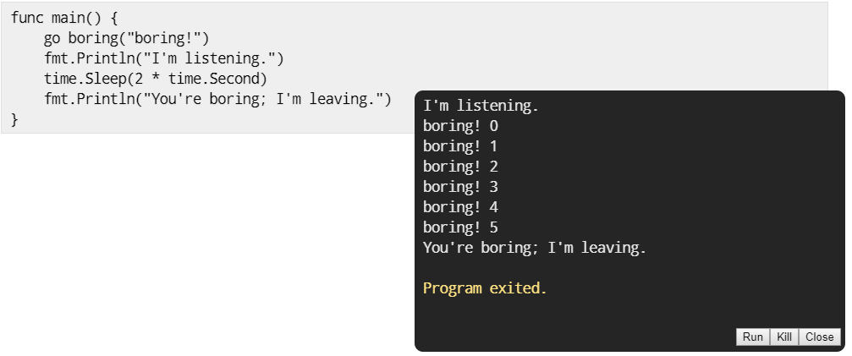
Example
The go statement runs the function as usual, but doesn't make the caller wait.
It launches a goroutine.
The functionality is analogous to the & on the end of a shell command.

Slide 7
Thank you for listening
Just add go before your method name and you will be fine.

Slide 8
What is goroutine
It's an independently executing function, launched by a go statement.
It has its own call stack, which grows and shrinks as required.
It's very cheap. It's practical to have thousands, even hundreds of thousands of goroutines.
It's not a thread.
There might be only one thread in a program with thousands of goroutines.
Instead, goroutines are multiplexed dynamically onto threads as needed to keep all the goroutines running.
But if you think of it as a very cheap thread, you won't be far off.

Slide 9
Communication
Our boring examples cheated: the main function couldn't see the output from the other goroutine.
It was just printed to the screen, where we pretended we saw a conversation.
Real conversations require communication.

Slide 10
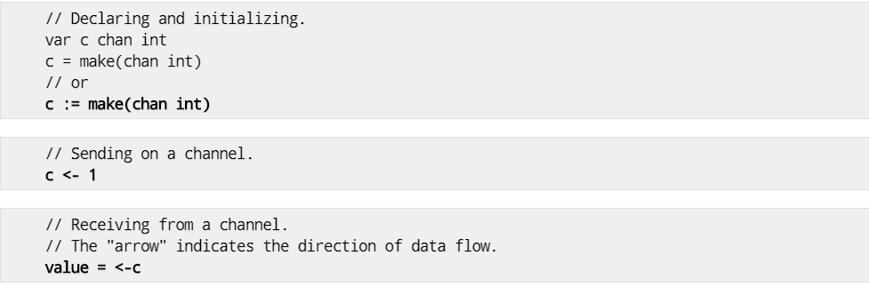
Channels
A channel in Go provides a connection between two goroutines, allowing them to communicate.

Slide 11
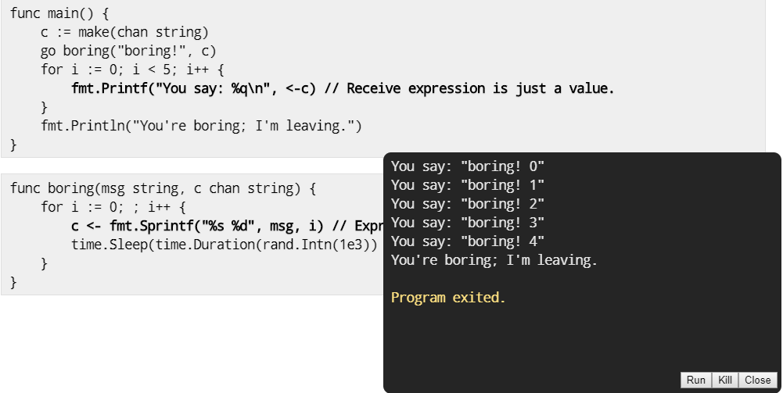
Using channels
A channel connects the main and boring goroutines so they can communicate.

Slide 12
Synchronization
When the main function executes <–c, it will wait for a value to be sent.
Similarly, when the boring function executes c <– value, it waits for a receiver to be ready.
A sender and receiver must both be ready to play their part in the communication. Otherwise we wait until they are.
Thus channels both communicate and synchronize.
Don't communicate by sharing memory, share memory by communicating.

Slide 13
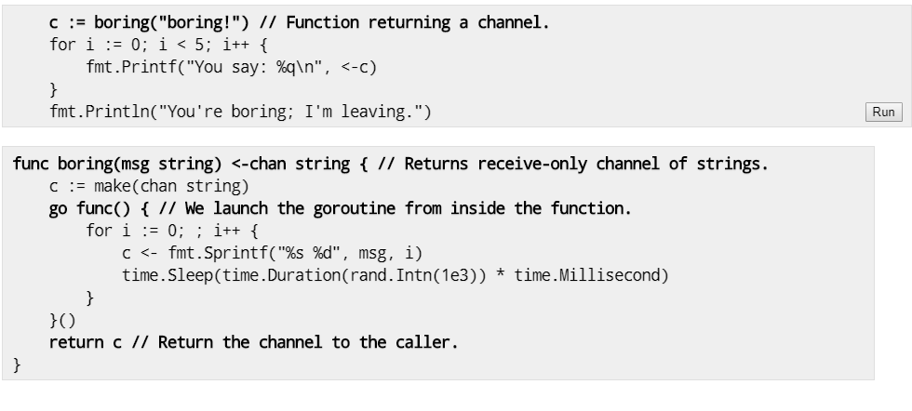
Generator: function that returns a channel
Channels are first-class values, just like strings or integers.

Slide 14
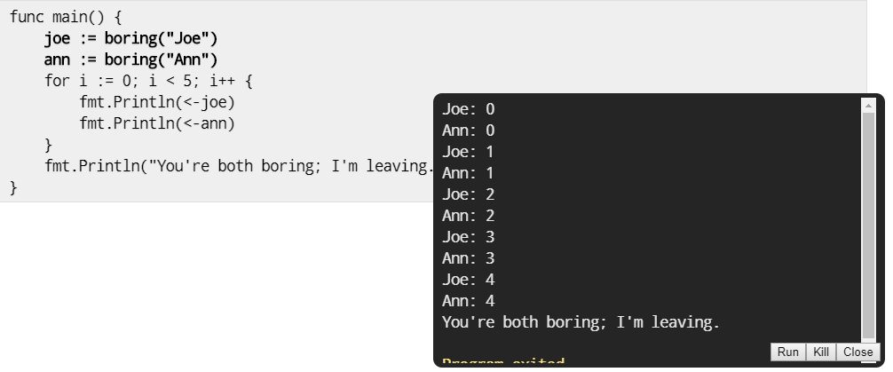
Channels as a handle on a service
Our boring function returns a channel that lets us communicate with the boring service it provides.
We can have more instances of the service.

Slide 15
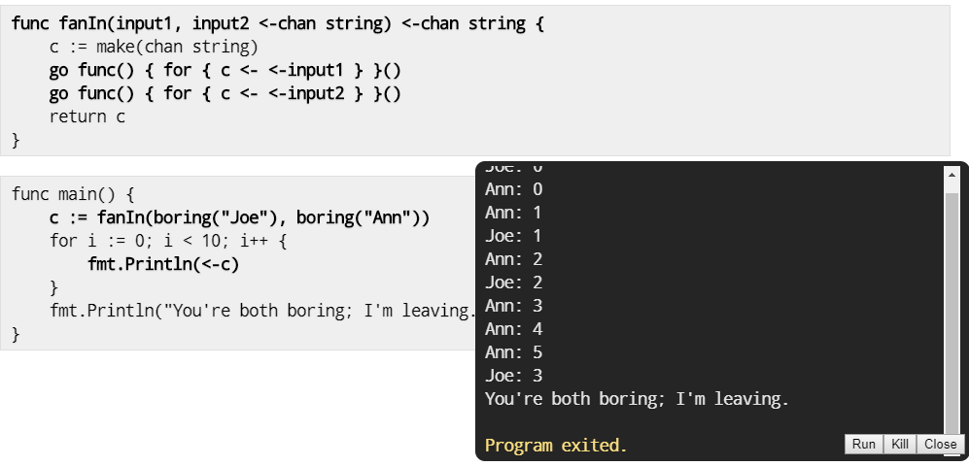
Multiplexing
These programs make Joe and Ann count in lockstep. We can instead use a fan-in function to let whosoever is ready talk.

Slide 16
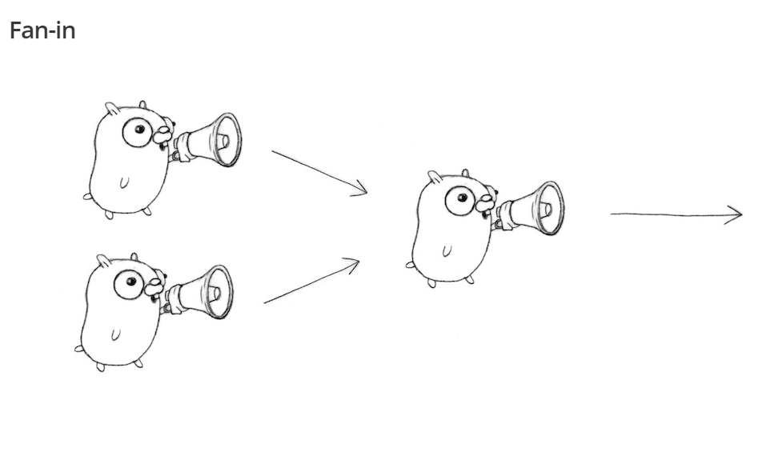

Slide 17
Select
A control structure unique to concurrency.
The reason channels and goroutines are built into the language.

Slide 18
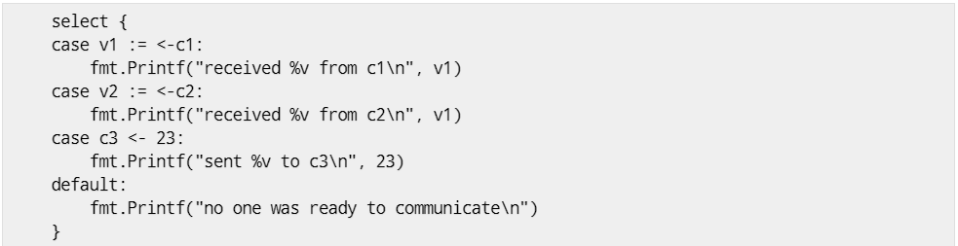
Select
The select statement provides another way to handle multiple channels. It's like a switch, but each case is a communication: - All channels are evaluated. - Selection blocks until one communication can proceed, which then does. - If multiple can proceed, select chooses pseudo-randomly. - A default clause, if present, executes immediately if no channel is ready.

Slide 19
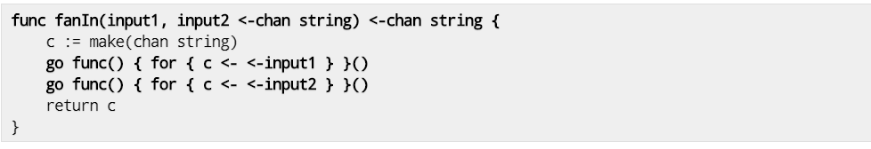
FanIn using Select
Rewrite our original fanIn function. Only one goroutine is needed.
Old:

Slide 20
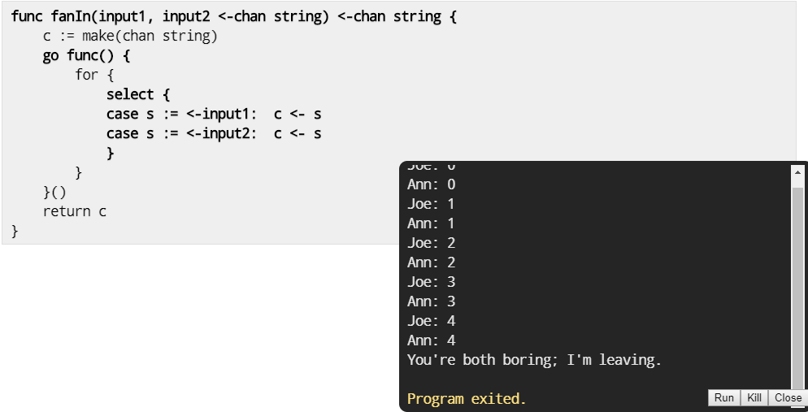
FanIn using Select
Rewrite our original fanIn function. Only one goroutine is needed.
New:

Slide 21
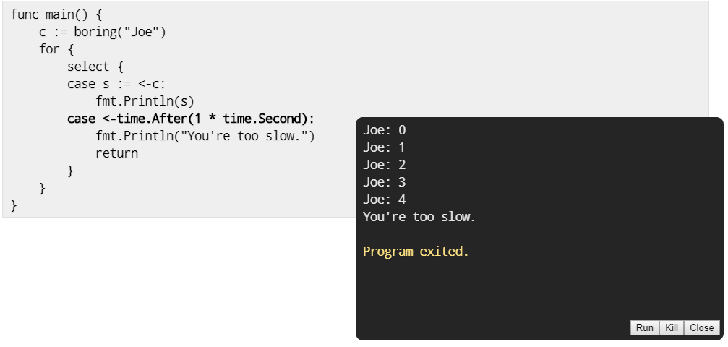
Timeout using select
The time.After function returns a channel that blocks for the specified duration. After the interval, the channel delivers the current time, once.

Slide 22
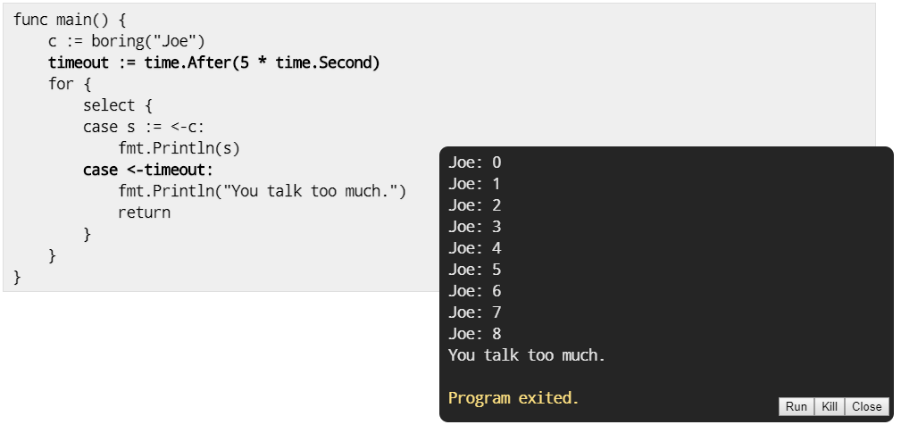
Timeout for whole conversation using select
Create the timer once, outside the loop, to time out the entire conversation. (In the previous program, we had a timeout for each message.)

Slide 23
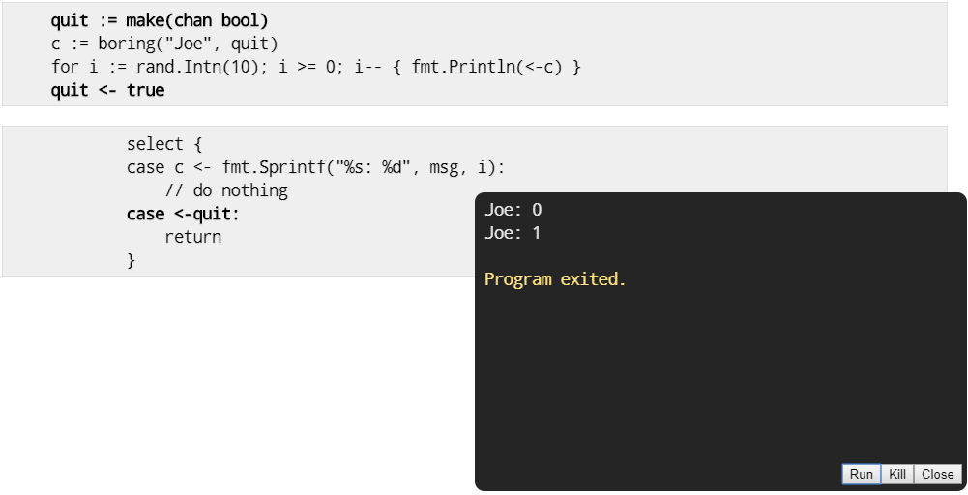
Quit channel
We can turn this around and tell Joe to stop when we're tired of listening to him.

Slide 24
Some other patterns:
- Worker pool using buffered channels
- Using WaitGroup
Examples:
Chatroulette toy:
golang.org/s/chat-roulette
Load balancer:
golang.org/s/load-balancer
Concurrent prime sieve:
golang.org/s/prime-sieve
Concurrent power series (by McIlroy):
golang.org/s/power-series

Slide 25
Thanks

